Slide 1

Anomaly Detection Algorithms, Use-case, and Hands-on
17 December, 2020
Short-Term Training Program on Machine Learning
Organized by - Department of CSE, MRIIRS

Slide 2

About me
Data Scientist, CHECK24 Comparison Portal (Germany)
Working with Recommender Systems, E-mail Classifications, NLP, Price Forecasting, Image categorization, etc.
Former Data Science Researcher, Fraunhofer IEM (Germany)
Development and validation of a data-driven condition monitoring system for smart factory
Master of Science - Computer Engineering, University of Paderborn (Germany)
Specialization in Signal, Image, and Speech Processing
Master Thesis: Using Deep Learning for Anomaly Detection in Autonomous System
Bachelor of Technology – GGSIPU, Delhi (India)
Specialization in Microelectronics and Hardware Programming
Nikhil Kumar Jha

Slide 3
Outline
Introduction
Anomaly Detection
Outlier vs Anomalies vs Noise
Causes of Anomalies
Key components
Challenges
Problem Characteristics
Nature of Input Data
Type of Anomaly
Availability of Labels
Output of Anomaly Detection
Applications
Anomaly Detection Techniques
Classification-based ADT
Nearest Neighbor-based ADT
Use case
Hands-on Tutorial

Slide 4

Introduction
We are overwhelmed by the amount of data being collected every moment in this world, while at the same time we are starving for knowledge.
Digital Transformation
Industry 4.0
Digitalization
Predictive Analytics ….

Slide 5
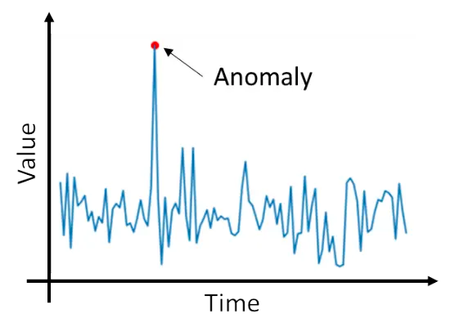
Anomaly Detection
Anomaly detection refers to the problem of finding patterns in data that don’t confirm to expected behavior.
Anomalies in data translate to significant, critical, and actionable information.
Based on the application domain, they are referred to as anomalies, outliers, exceptions, peculiarities, contaminants, etc.

Slide 6
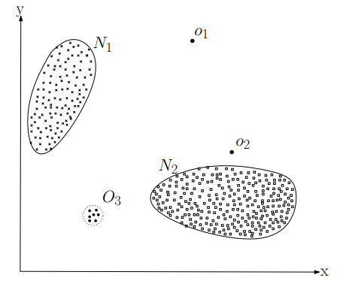
Outlier vs Anomaly vs Noise
An Outlier is a data point which deviates significantly from the other observations as to arouse suspicions that it was generated by a different process.
Anomalies are a special kind of outlier that has significant/ critical/actionable information which could be of particular interest to the analysts.
It is the analyst’s decision to determine what is considered as just an outlier or is an anomaly
Noise can be the unwanted objects which are a hindrance to the data analysis and should be removed.

Slide 7
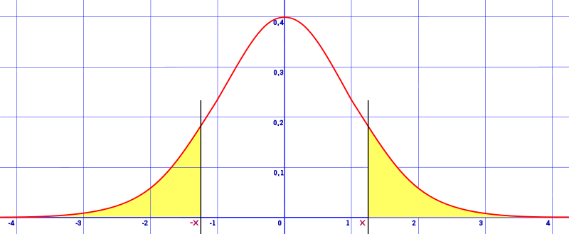

Causes of Anomalies
Observations from another process or belonging to a different class:
Malignant vs. Benign
Fraud vs. Valid
Natural variation:
Tails on a Gaussian distribution
Errors made during data collection
Faulty measurement systems
Human error (To err is human)

Slide 8
Challenges
Defining a boundary between normal and anomalous behavior is often not possible / precise
A normal observation near the boundary might be anomalous, and vice versa
Notion of anomaly is often different for different domains
Fluctuations in data from medical domain vs that from stock market affects us differently
In some domains, definition of normal behavior keeps evolving with time
A static definition might not be sufficiently representative in future
Labeled data is often unavailable for training and validation
At times, noise and anomalies look similar, and can‘t be easily distinguished

Slide 9
Key Components
Research Areas
Machine Learning
Application Domains
Intrusion Detection
Medical and Health Care Informatics
Problem Characteristics
Output of the technique
Type of anomaly
Statistics
Information Theory
Spectral Theory
Data Mining
Fault Detection
Military Surveillance
Fraud Detection
Availability of labels
Nature of data

Slide 10
Problem Characteristics
Nature of Input Data
Attributes
Sequence Data
Spatial Data
Binary
Categorical
Continuous
Time-series
Genome sequences
Protein sequence
Traffic Data
Climate Data
Ecological data
Type of Anomaly
Point
Contextual
Collective
Output of the model
Scores
Labels
Availability of Labels
Supervised
Semi-Supervised
Unsupervised

Slide 11
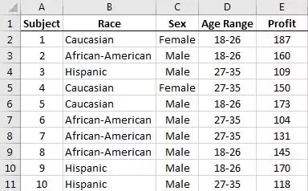
Nature of Input Data
Continuous
Nature of attributes:
Binary
Continuous
Categorical
Number of variables:
Univariate
Bivariate
Multivariate
Categorical
Binary

Slide 12
Type of Anomaly
Point Anomalies:
When a single data instance can be considered as anomalous with respect to the rest of the data.
Simplest form and has major focus in research community.
Example:
Credit card fraud detection Given user‘s daily expenditure dataset, any amount spent significantly higher than the normal range will be considered an anomaly.

Slide 13
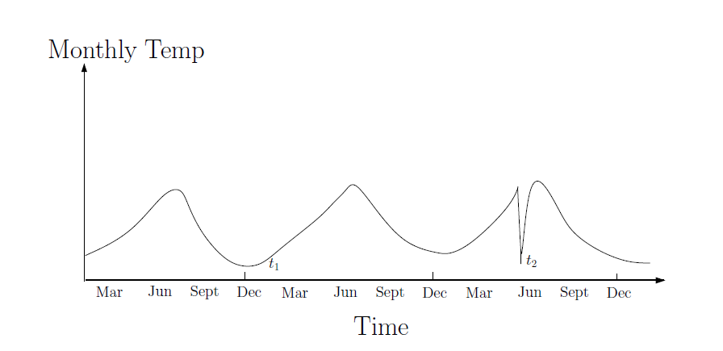
Type of Anomaly
Contextual / Conditional Anomalies:
When a data instance is anomalous in a specific context but not otherwise.
Dataset consists of:
Contextual attributes: Time, Geo-location, etc.
Behavioral attributes: Attributes complimenting the former with more information
Example:
Temperature recordings A low temperature recording in December (winter) might be normal, but the same during July (summer) would be an anomaly.

Slide 14
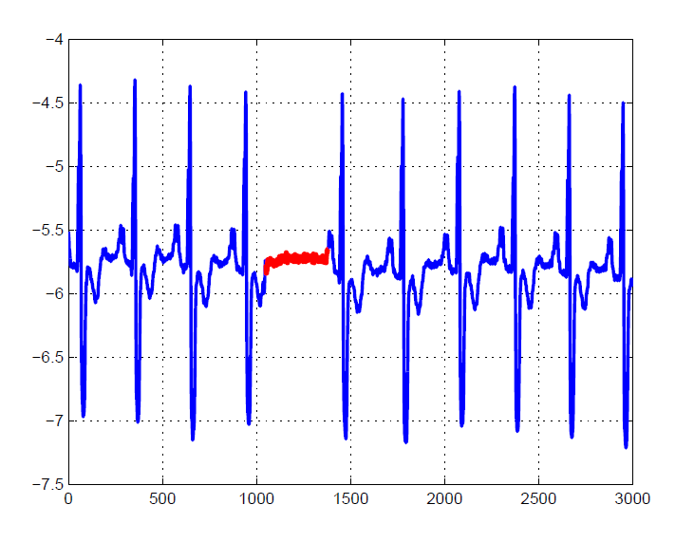
Type of Anomaly
Collective Anomalies:
When a collection of data instances are anomalous with respect to the entire data set.
The individual instances might not be anomalous by themselves.
Example:
Human electrocardiogram output A low value in itself is normal, but the same low value existing for an abnormally long time is anomalous (highlighted in red).

Slide 15
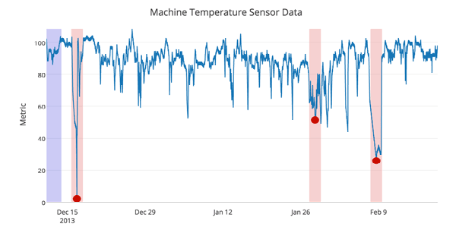
Availability of Data Labels
Labels associated with data instance denote normalcy or abnormality.
Obtaining labeled data is expensive and requires substantial effort.
Anomalies occur very rarely, and often are not present in collected data.
Anomalous behavior is dynamic in nature, and new anomalies might arise for which no labeled data is available.

Slide 16
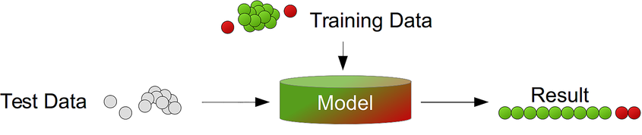
Availability of Data Labels
Supervised Anomaly Detection:
Assumes that all the training instances are labeled
Typical approach is to go for a predictive model for normal vs anomalous classes
Unseen data instances are processed by the model to see which class it belongs to
Challenges:
Dataset has imbalanced class distributions → a biased model
Obtaining the labels is expensive

Slide 17
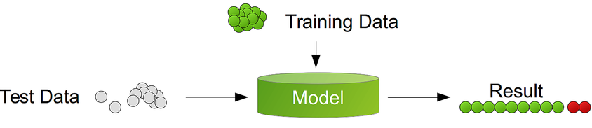
Availability of Data Labels
Semi-Supervised Anomaly Detection:
Assumes that labeled data is available only for normal class.
Build a model for the normal behavior, and use it to identify anomalies in the test data.
Since labels for anomalous class aren‘t required, there techniques are preferred over the former.

Slide 18
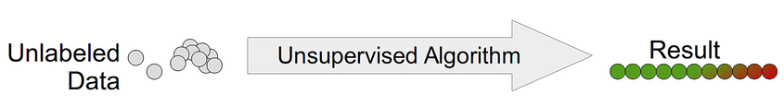
Availability of Data Labels
Unsupervised Anomaly Detection:
These techniques do not require training data, and are most widely applicable.
Implicit assumption: Normal instances are far more frequent than the anomalies.
When the assumption is not true, these model suffer from high false positive rate

Slide 19
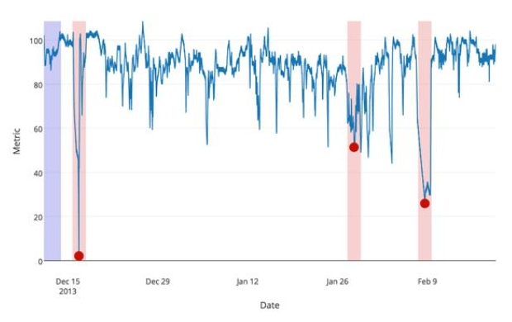
Output of Anomaly Detection
Scores
Assign a score to each instance in the test data based on the degree to which it is considered an anomaly.
Analyst may decide a threshold to analyze only the top few instances with highest score.
Labels
Assign a label (normal / anomalous) to each test instance.
Analysts can not directly select a domain-specific threshold to identify the most relevant anomalies, but can do so using parameter choices.

Slide 20
Applications
Anomaly detection finds extensive use in a wide variety of applications such as
Credit card fraud detection
Intrusion detection for cyber security
Abnormal activities in autonomous driving systems
Fault detection in health-care and safety critical systems
Irregularity in manufacturing processes
Surveillance and other military activities

Slide 21

Applications
Intrusion Detection
Detection of malicious activity in a computer related system.
Interesting from a computer security perspective.
Huge volume of data requires computationally efficient techniques.
Typically used in an online fashion on streaming input.
Semi-supervised or unsupervised techniques are preferred since normal data is available.

Slide 22

Applications
Fraud Detection
Detection of criminal activities in commercial organizations like bank, insurance agency, stock market, etc.
Malicious users exploit the resources in an unauthorized way.
Immediate detection is necessary to prevent economic losses, and thus online detection is required.
Frauds get typically reflected in transactional records.

Slide 23
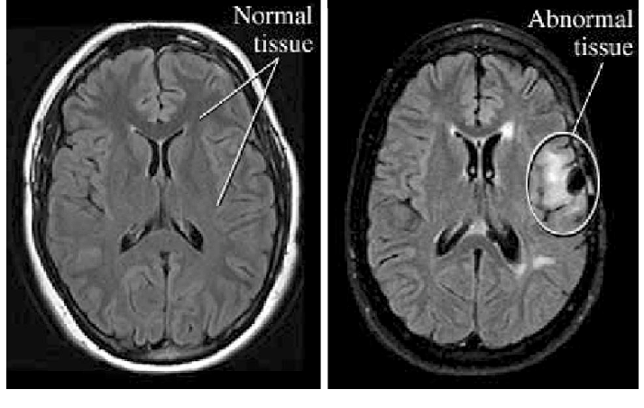
Applications
Medical Health
Typically dealing with patient records.
Anomalies exist due to abnormal patient conditions, instrumentation errors, etc.
Requires highest degree of accuracy.
Labeled data of healthy people is available motivates to use semi-supervised approach.
Cost associated with misclassifications is high.

Slide 24
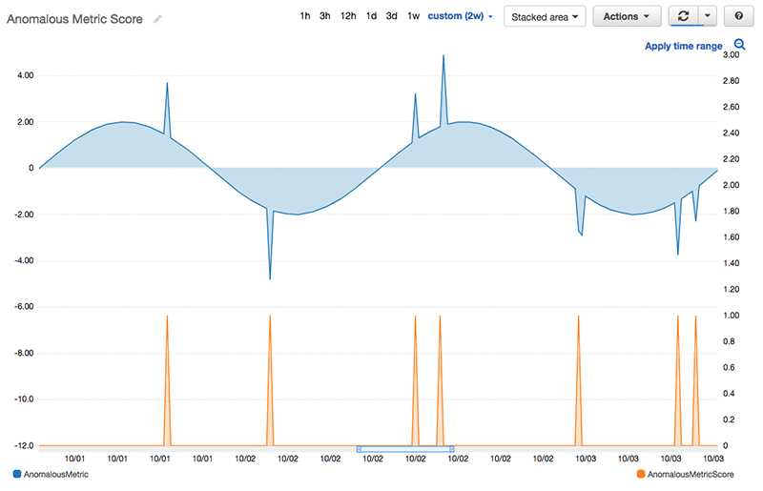
Applications
Fault Detection in Industries
Machine units suffer damage due to continuous usage
Their early detection can prevent escalations and losses.
Data generally collected by the mounted sensors.
An important part of Industry 4.0 and Predictive Maintenance
Preventive measures need to be taken as soon as anomaly occurs, and thus requires an online setting.

Slide 25
Anomaly Detection Techniques (ADT)
Techniques
Classification-based
Nearest Neighbor-based
Statistical
Information Theoretic
Clustering-based
Every technique has a unique assumption about the nature of anomaly, data, etc. to be able to correctly detect anomalies.
Each technique has it‘s unique set of advantages and disadvantages, and an assorted computational complexity.
In each category, there exists a base technique, and all others in that category are variants of it.

Slide 26
Classification-based ADT
This technique operate in a two-phase fashion:
The training phase learns a classifier using the available labeled training data.
The testing phase classifies a test instance as normal or anomalous using the classifier.
Assumption: “A classifier that can distinguish between normal and anomalous classes can be learnt in the given feature space.”
Based on the labels available for training, it can be grouped into two broad categories:
Multi-class ADT
One-class ADT

Slide 27
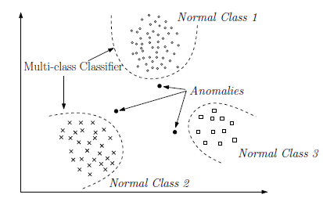
Classification-based ADT
Multi-class classification
Assumes that the training data contains labeled instances from multiple normal classes.
Learn a classifier to distinguish between each normal class against the rest of classes.
A test instance is considered anomalous if its not classified as normal by any of the classifiers.

Slide 28
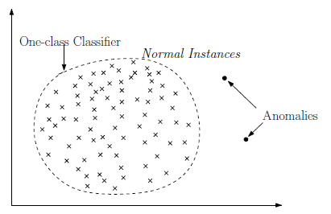
Classification-based ADT
One-class classification
Assume that all training instances have only one class label.
Learn a discriminative boundary around the normal instances using a one-class classification algo.
A test instance not falling within the learnt boundary is anomalous.

Slide 29
Classification-based ADT
Various ADT using classification algorithms to build classifiers:
Neural Network-based
Bayesian Networks-based
Support Vector Machines-based
Rule-based
Advantages: Fast testing phase with precomputed model, powerful classification algorithms
Disadvantages: Reliance on availability of accurate labels

Slide 30
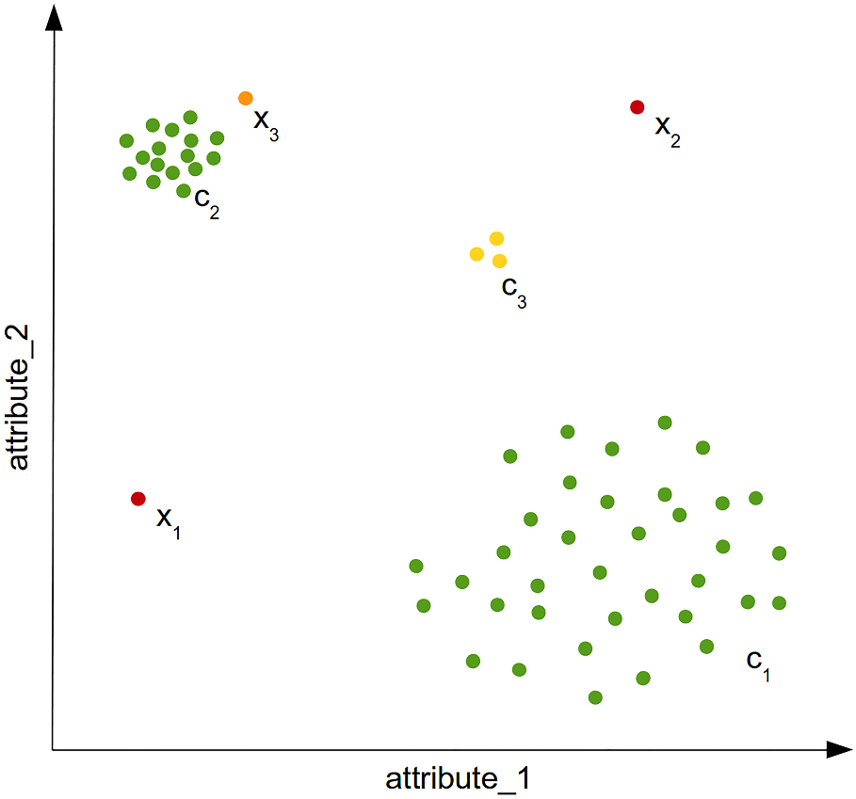
Nearest Neighbor-based ADT
These ADT require a distance or similarity measure defined between two data instances, which is used in different ways to detect anomalies.
Assumption: “Normal data instances occur in dense neighborhoods, while anomalies occur far from their closest neighbors.”
They can be broadly grouped into two categories based on if they calculate:
Global density or
Relative density

Slide 31
Nearest Neighbor-based ADT
Global Density
Counting the number of nearest neighbors that are not more than d distance apart from the given data instance.
Involves counting the K number of nearest neighbors to the data instance.
Anomaly are data points whose distance to the Kth nearest neighbor is greatest.
Relative Density
Density based anomaly detection techniques estimate the density of the neighborhood of each data instance.
Data instances in low density neighborhood is considered anomalous and vice-versa.
Anomaly are data points for which there are fewer than P neighboring instances within a distance D.

Slide 32
Nearest Neighbor-based ADT
Advantages:
Can work in unsupervised setting; works even better in semi-supervised fashion.
Adapting to a different data type is straight forward.
Disadvantages:
Anomalies are not always isolated from normal instances.
High computational complexity.
Performance depends on the selection of the distance measure.

Slide 33
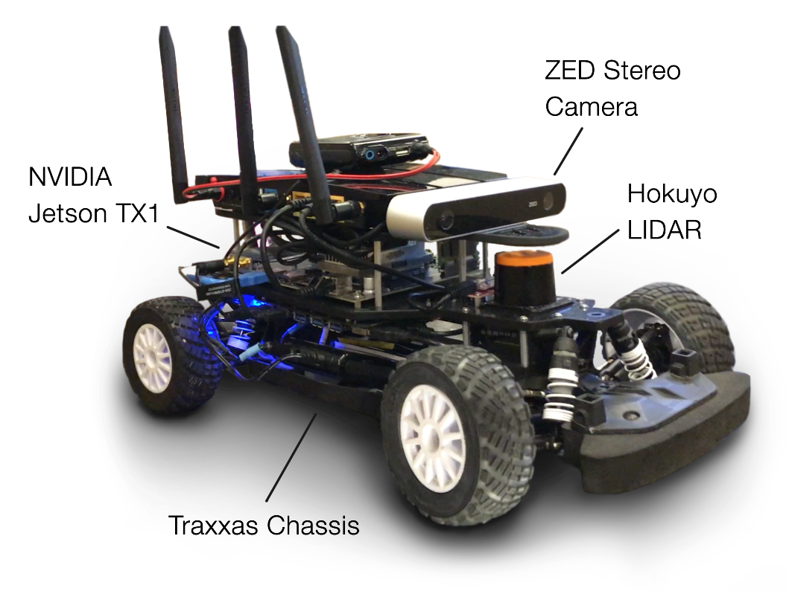
Use case
Artificial Intelligence for Autonomous Systems
Idea: In future, autonomous systems can “heal” themselves in case of functional failures
Utilize the principles of biological immune system and artificial intelligence
Focus on smart factory applications (Industry 4.0)
Detect
anomalies
Evaluate the
cause
Observe
Analyse
Execute
Plan
Perform self-healing process
Decide actions to be taken

Slide 34
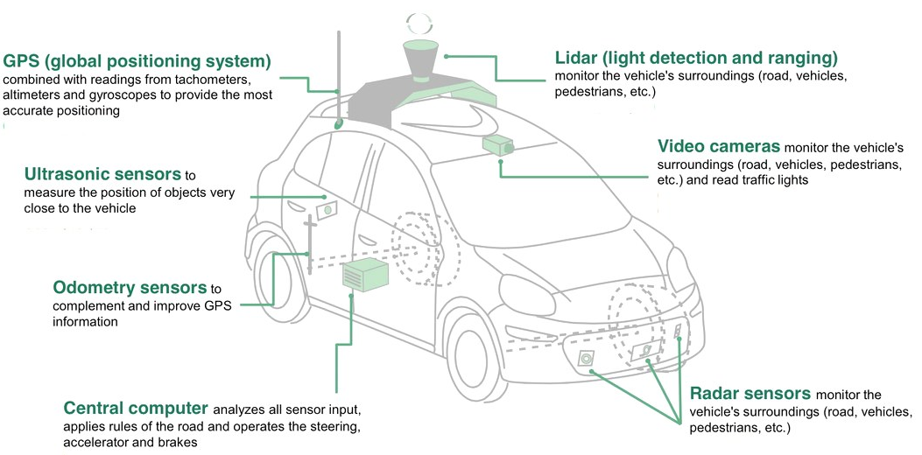

Use case

Slide 35

Use case

Slide 36
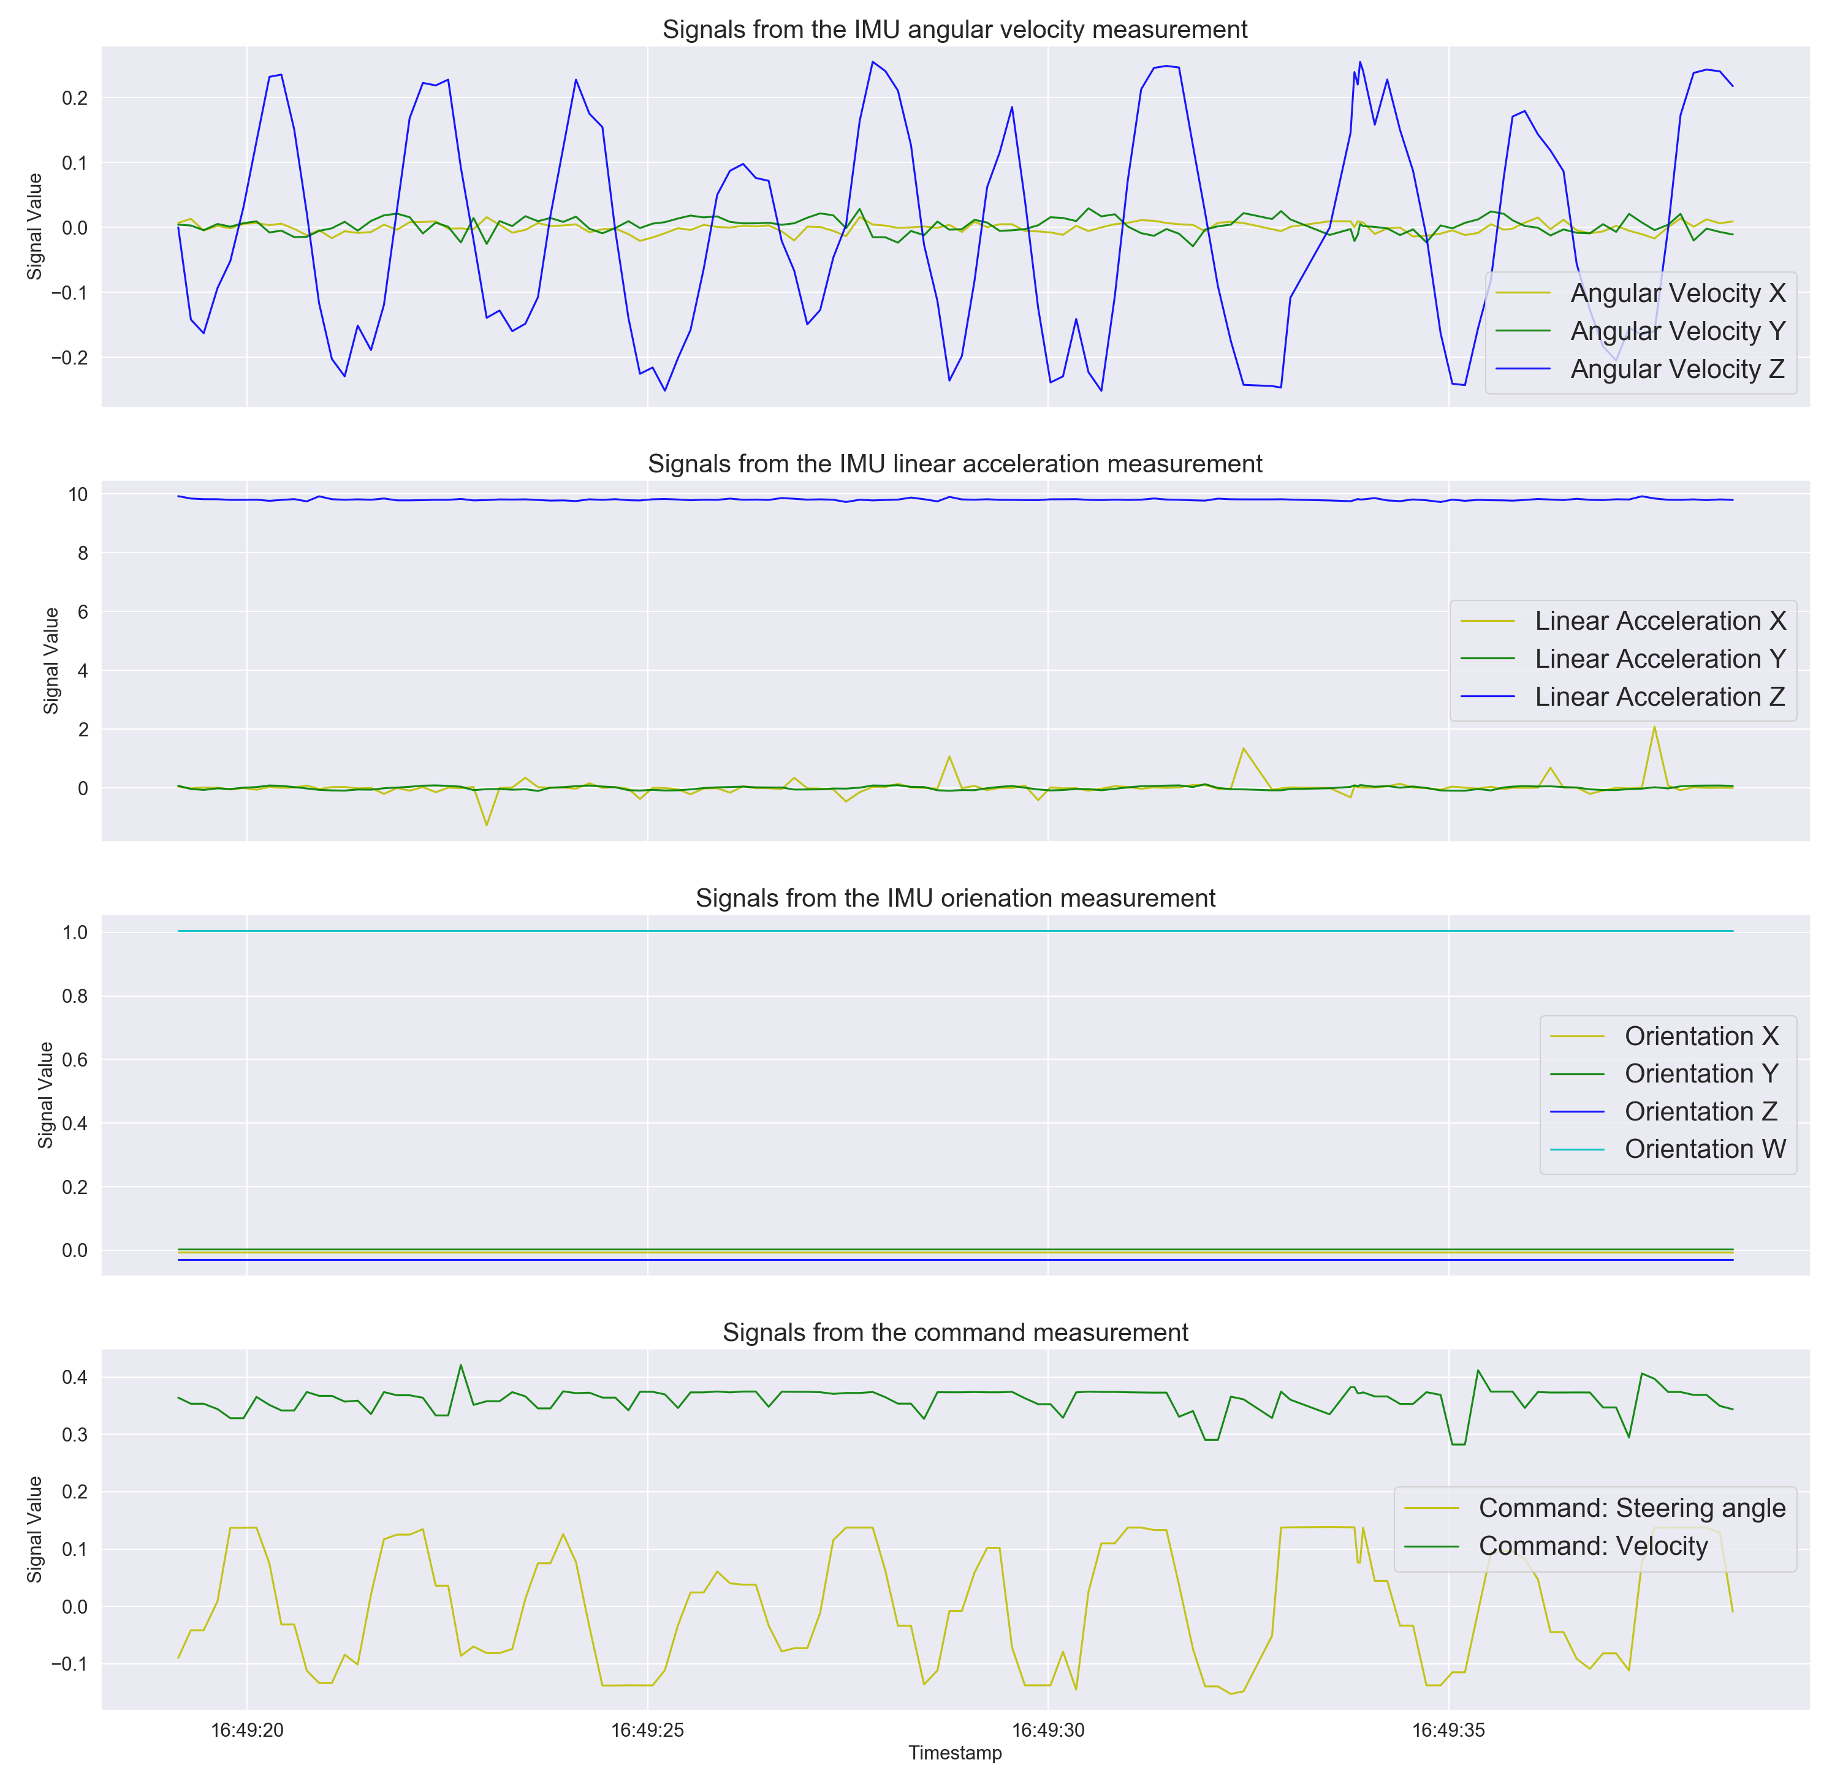
Use case

Slide 37
Use case
Algorithms used
Isolation Forest
One-class Support Vector Machine
Angle-based Outlier Detector
Local Outlier Factor
Autoencoder

Slide 38
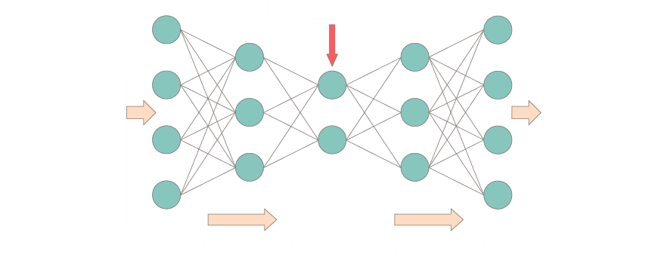
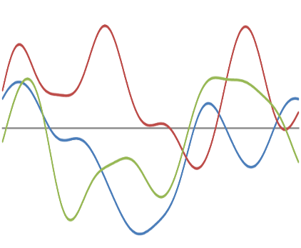
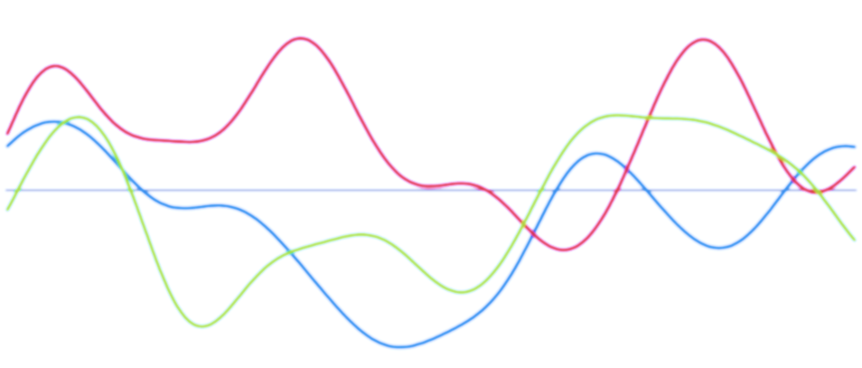
Use case
Autoencoder
Compressed data representation
Input data
Reconstructed output
Encoder
Decoder

Slide 39
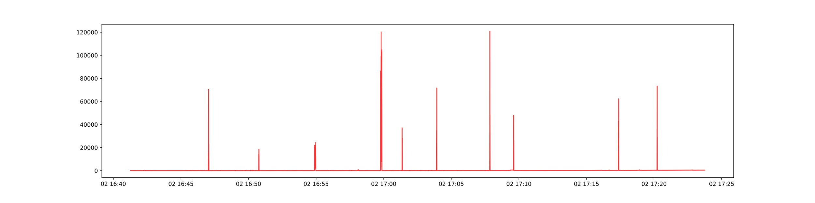
Use case
Reconstruction error
Ground truth anomaly
Autoencoder Results

Slide 40
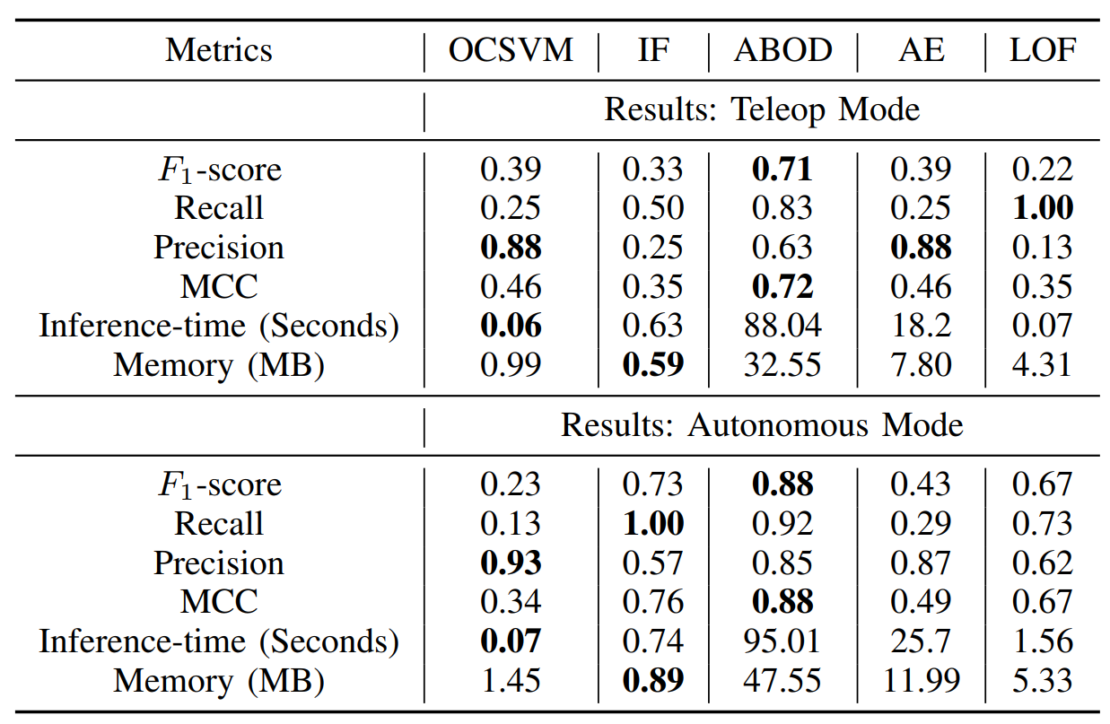
Use case
Results
MCC is a balanced measure which can be used even if the classes are of very different sizes.
Recall is proportion of actual anomalies that are correctly identified by the AD.
Precision is the proportion of predicted positive labels (anomalies) that are correct.
Inference time is the time taken by a trained model to produce anomaly score for each data point.

Slide 41

Hands-on Training

Slide 42
Conclusion
Anomaly Detection can detect critical information in data.
Nature of anomaly depends on the application domain.
The performance of different methods depends a lot on the data set and parameters.
Advantages over another when compared across many data sets and parameters.
No free lunch – one single algorithm can not be used for every problem.

Slide 43

Questions
Nikhil Kumar Jha
Data Scientist | CHECK24 Vergleichsportal
Master of Science - Computer Engineering
website: www.linkedin.com/in/nikhil-kumar-jha
email: kumar.nikhil936@gmail.com

